Slide 1
UI X
Maria Markosova

Slide 2
Last lecture
State space, state variables , evidence variables.
Filtering and prediction in time series with uncertainty.
Solutions in the Umbrella world example.

Slide 3
Outline
Smoothing, most likely sequence. Kalman filter.
Introduction to the decision theory.
Simple and complex decisions.
Single and multiattribite utility function.
Monetary utility example.
Human decisions.

Slide 4
Smoothing: We calculate
- Bayes rule used
-notion of conditional independency used
This is in fact filtering
This we need to elaborate

Slide 5
Recursion formula
Markovian condition
Recursive element
Known from the model

Slide 6
Smoothing in the „umbrella world“
We want to know smoothed estimate of the rain probability at the time t=1, providing we have an observations of the umbrella appearance for the first two days (t=1,2) and we know that the umbrella appeared the first and the second day as well.
**
Known from the previous calculations
Gained by a recursive process

Slide 7
Recursion
Using the equation **:
Smoothed estimate is higher then the filtered estimate. The reason is that the rain has a tendency to continue for several days. Umbrella appearance at the day 2 signalized that the probability of the rain at the day 1 might be higher as estimated by filtering.

Slide 8
Time series with uncertainty – preliminary summary
Prediction:
Filtering:
Smoothing:

Slide 9
4. Most likely sequence and the Vitterbi algorithm
The meaning of the formula: Let us have certain observed sequence (true,true,false,true,true) the number of observations is t+1. We can find conditional probability for an arbitrary sequence of states . But we look for such sequence of states x, for which the probability is maximal providing the given observation sequence

Slide 10
Viterbi algorithm
true
true
true
true
true
false
false
false
false
false
Umbrella true true false true true
0.8182
0.5155
0.0361
0.0334
0.0210
0.1818
0.0491
0.1237
0.0173
0.0024

Slide 11
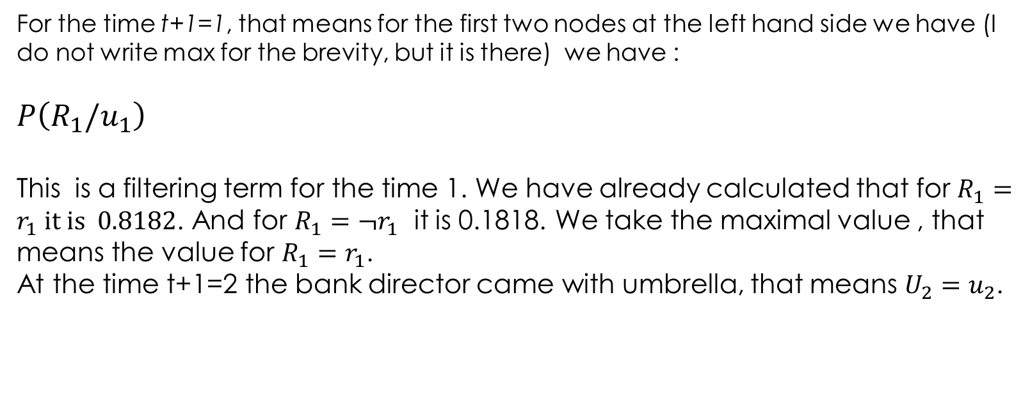
For the time t+1=1, that means for the first two nodes at the left hand side we have (I do not write max for the brevity, but it is there) we have :
$$P\left(R_{1}/u_{1}\right)$$
This is a filtering term for the time 1. We have already calculated that for $R_{1}=r_{1} it is 0.8182$. And for $R_{1}={¬r}_{1}$ it is 0.1818. We take the maximal value , that means the value for $R_{1}=r_{1}$.
At the time t+1=2 the bank director came with umbrella, that means $U_{2}=u_{2}$.

Slide 12
These are values for the second leftmost nodes in the graph. Alpha is already hidden here:
I strongly recommend to find the values for the third leftmost nodes in the state graph hodnoty. Take care, observation in this case is

Slide 13
Kálman filtering
With a help of Kálman filters it is possible to estimate a state of the system in a case of inexact noisy measurement, providing we know the (linear in the most simple case) process creating the time series in question.
Examples: Kepler task – the planet movement reconstruction from the noisy
measurements of planet location in different time intervals.
K. filters were successfully used in the Apollo spacecraft navigation unit.
K. filters are widely used in GPS systems and for robot navigation in AI

Slide 14
Kálman filter principle
Principle : Clever usage of the basic formula for filtering, properties
of the Gaussian noise and linearity of the process (in the most simpe case).
Filering in general:
update to the last measurement
One step prediction

Slide 15
-state variable
-equation of the linear process , where is a Gaussian noise with zero mean value and the variation Q
- constant, for example
We have a knowledge about the linear process but we do not have an exact measurement of the state and we do not know how the noise influences our measurements.

Slide 16

Let us suppose we are sailing on one dimensional sea and we are trying to guess our position from the noisy measurements. It is night and dark. At the time t=0 our friend the captain told; I think we are at the position but the error can be great. Variation of the estimate error is P.
value which starts the filter
estimate error
variation of the estimate error

Slide 17
Real location of the ship at time t=1
best estimate of
- because the best estimate of the Gaussian noise value is its mean value (which is zero as defined before)
- because

Slide 18
We have an estimate and now we make a noisy measurement of this value . Measurement is linearly related to the real value
Measurement noise is Gaussian with zero mean and variation R. Let M=1 .

Slide 19
Estimate of :
Kálman assumtion: The best estimate (estimate of the ship location at the time t=1) one gets if one includes a noisy measurement in to the estimate.
Kálman gain, chosen to minimize the estimate error

Slide 20
How to get the Kálman gain
Let us minimize the estimate error (mean square error):
Kálman gain should minimize the estimate error, so

Slide 21
And from the previous equation we get:
- Kálman gain

Slide 22
Kálman filter:
Prediction
Estimate of variation
Update of the prediction by the measurement
Kálman gain
Better estimate which includes measurement

Slide 23
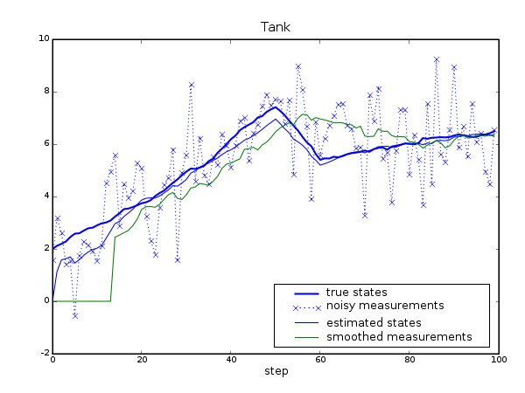
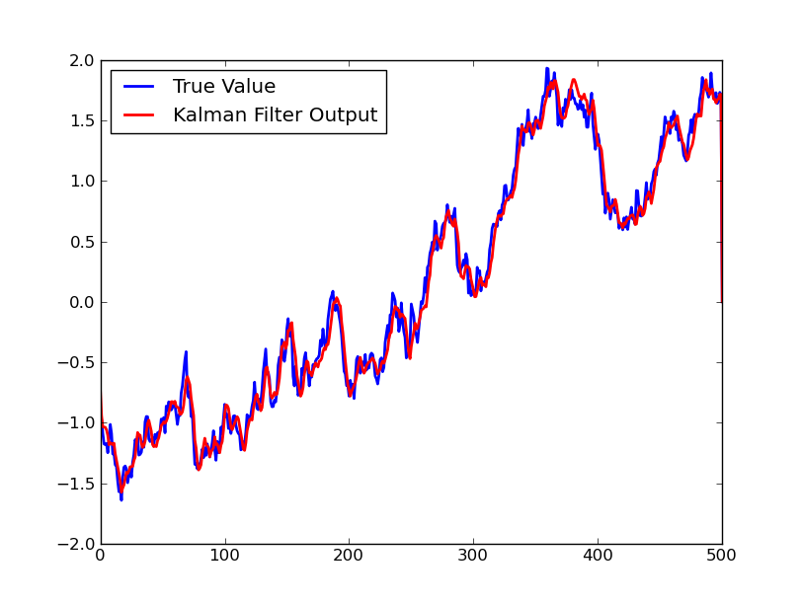
The Kalman filter is asked to estimate the amount of liquid in the tank.
Kálman filter output
Gauss-Markov process

Slide 24
Preliminary summary
We finished the series with uncertainty, where we have been talking about Markovian processes. Based on the example of the Markovian process of the first order, we know
What is filtering and prediction
How to do smoothing
How to calculate the most likely sequence of states providing we have a sequence of measurements.
One example of filtering… Kalman filter.

Slide 25
Decision theory
In AI combines the utility theory with the probability theory. Utility functions estimate whether the state is appropriate for the agent on the basis of agent’s gain estimate in a current state. Probability theory estimates with which probability the agent gains the utility making certain decision. Agent’s decisions should maximize the expected utility: agent uses the MEU principle ( Maximum Expected Utility) to make a decision.

Slide 26
Notation
Result of the action a in a state s. The result can be a new state s’.
If the result of certain action a is not deterministic, we only know the probability by which the agent gets into the state s´, e are observations.
Utility of the state s is a number, while U is an utility function.

Slide 27
Expected utility
MEU principle: rational agent chooses such action (or an action sequence), which makes the expected utility maximal.
Simple decision: On the basis of the MEU principle agent decides about the next action from the set of possible actions in the current state.
Complex decision: Agent decides about the sequence of actions from the possible set of actions.

Slide 28
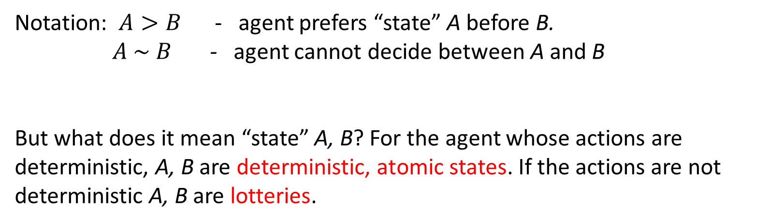
Simple decision. Preferencies of the decision agent
Notation: $A>B$ - agent prefers “state” A before B.
$A \sim B$ - agent cannot decide between A and B
But what does it mean “state” A, B? For the agent whose actions are deterministic, A, B are deterministic, atomic states. If the actions are not deterministic A, B are lotteries.
Example: Agent looking for a route on map performing a deterministic action Move(London, Paris) moves from the state s (to be in London) to the state s’(to be in Paris). If the action Move(London, Paris) is not deterministic, the result is a lottery. With certain probability he will stay in London and with certain probability he will be in Paris after the action execution.

Slide 29
Lottery: probability distribution of the action results
Lottery L with possible action results , having probabilities
can be formally denoted as :
Meaning: Result occurs with the probability .
Atomic state is a lottery with one result only. The notation is A, or L=[1,A]
Result of the lottery: 1. Atomic state
2. Lottery again

Slide 30
Examples of lotteries:
Coin tossing:
Tripple coin tossing: order of O, H does not matter. What it is mathematically?
Combinations with repetitions: $\left(\begin{matrix}m+n−1 \\ n−1\end{matrix}\right)$, n number of objects (coin sides, orol, hlava), number of picked objects (tosses). n=2, m=3
This is a case in which the order of hlava result and orol result does not matter.

Slide 31
How many possible action results we have if in the triple coin toss the order of coin sides matters?
What it is mathematically?
They are three element variations with repetition from the two items O and H.
The number of such variations is , where n is the number of items (O,H) and m is an order of m-plet (m=3).

Slide 32
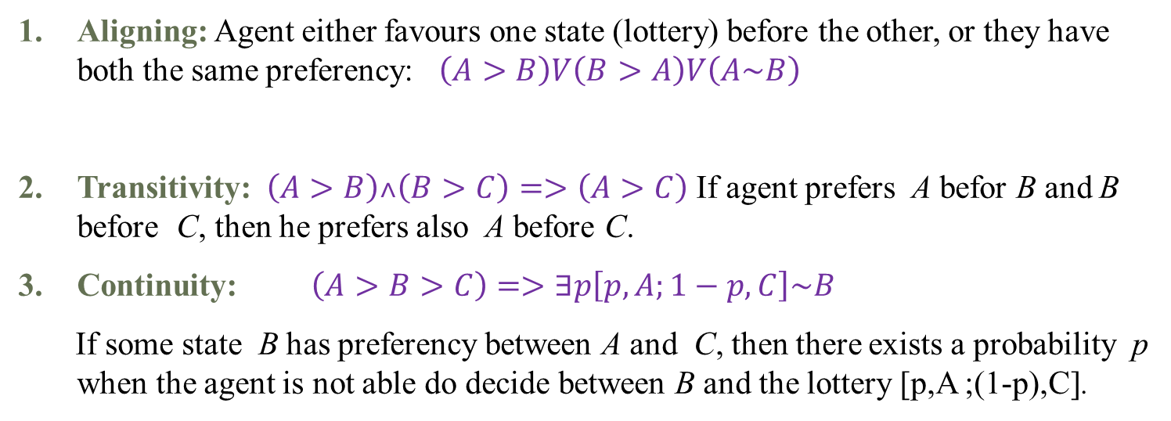
Utility theory and its constraints:
Preferencies of the rational decision agent:
Aligning: Agent either favours one state (lottery) before the other, or they have both the same preferency: $\left(A>B\right)V\left(B>A\right)V\left(A\sim B\right)$
Transitivity: $\left(A>B\right)˄\left(B>C\right)=>\left(A>C\right)$ If agent prefers A befor B and B before C, then he prefers also A before C.
Continuity: $\left(A>B>C\right)=>∃p\left[p,A;1−p,C\right]\sim B$
If some state B has preferency between A and C, then there exists a probability p when the agent is not able do decide between B and the lottery [p,A ;(1-p),C].
lottery

Slide 33
Utility theory and its constraints:
Replacement: If an agent cannot choose between A and B lotteries, then he also cannot choose between more complex lotteries if in one of them is B replaced by
A.
$$A\sim B=>\left[p,A;1−p,C\right]\sim \left[p,B;1−p,C\right]$$

Slide 34
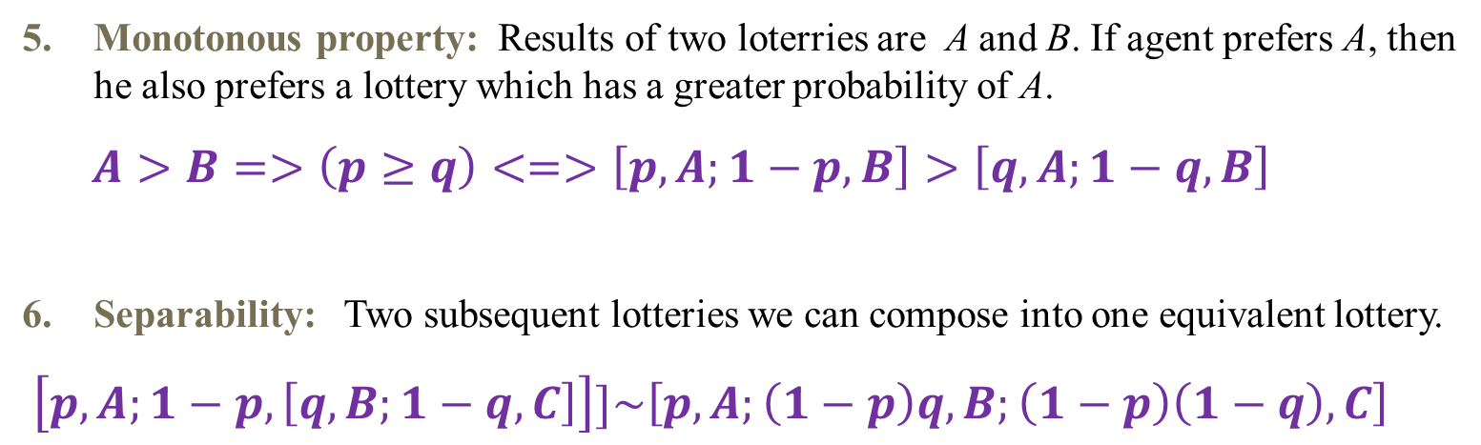
Utility theory and its constraints:
Monotonous property: Results of two loterries are A and B. If agent prefers A, then he also prefers a lottery which has a greater probability of A.
$A>B=>\left(p≥q\right)<=>\left[p,A;1−p,B\right]>\left[q,A;1−q,B\right]$
Separability: Two subsequent lotteries we can compose into one equivalent lottery.
$\left[p,A;1−p,\left[q,B;1−q,C\right]\right]]\sim \left[p,A;\left(1−p\right)q,B;\left(1−p\right)\left(1−q\right),C\right]$

Slide 35
Axiom of utility
Utility principle: If the agent controls his preferencies according 6 previous constraints, then there exists a function U. The outcome of this function is a real value. The function is defined on states and U(A)>U(B) if and only if A is preferred before B. U(A)=U(B) if and only if the agent cannot decide between A and B.
Utility of a lottery is a sum of the result utilities multiplied by the probabilities of the outcomes (results)

Slide 36
Utility functions
Single attribute, depends only on one variable , one attribute. Example : monetary utility function, in which the only attribute is the amount of money
Multi attribute, depends on many attributes, variables. Example: we want to buy a car. Our decision is influenced by the price, type, color, power …. Etc , utility function of the car has all of these attributes.

Slide 37
Summary
Smoothing and most probable state sequence.
Applications of filtering – Kalman filter.
Introduction to the decision theory: atomic state, lottery, utility function.

